Slide 1


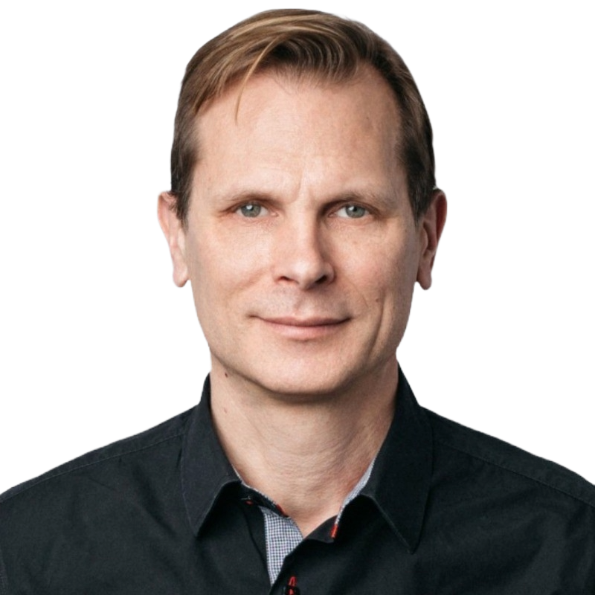







POSSIBILITY IS IN THE ASCENT
Reinserting Capitalism into Healthcare with Elan Adler, CEO of OneImaging
Podcast Episode Release – November 2025
Elan Adler
Chief Executive Officer
Frederic Laurier
Managing Director, HealthTech
Ricky Zhu
Analyst, HealthTech
Episode Highlights
Elan’s lifelong journey in radiology began as a teenager helping with his father’s mobile x-ray business, ultimately leading him to found OneImaging to fix inefficiencies he experienced firsthand
Imaging decisions are often made without real transparency
  Patients rely on provider referrals to clinics without knowing whether they’re receiving in-network options, the sticker price (MRIs can cost anywhere from $1,000 - $3,000)
  By the same token, providers often do not have have clear visibility into quality or capability across imaging centers
Cancellation rates for imaging appointments average around 25%, often driven by uncertainty – unclear costs, delayed authorizations, and anxiety about the exam itself
Navigating healthcare marketplaces requires building across two regulated worlds — financial and clinical
Imaging today is used primarily for diagnosis, but it holds untapped potential as a proactive tool for preventive care – i.e., detecting early indicators of diseases like osteoporosis long before symptoms appear
www.alantra.com/crossroads-by-alantra/

Slide 2
Reinserting Capitalism into Healthcare with Elan Adler, CEO of OneImaging | Podcast Episode Release | 2
Episode Transcript
Frederic Laurier (00:06):
Welcome to another episode of Crossroads by Alantra, where we explore the cutting edge of healthcare technology innovation. In this session, we have the privilege of hosting Elan Adler, the founder and CEO of OneImaging. OneImaging operates as a radiology marketplace, streamlining payment rails and operational processes for nearly 5,000 providers, cutting costs by an average of 68% and cancellations from 25% to under 1%. Elan shares his lifelong involvement in radiology and inspiration behind founding OneImaging, driven by personal experiences, highlighting inefficiencies, and lack of transparencies in medical imaging access and costs. We conclude this session with Elan discussing the untapped potential of imaging data for preventive care to detect early indicators of conditions like osteoporosis and promoting longitudinal health insights. We hope you find this interview as enlightening and insightful as we did.
(01:02):
Welcome to another episode of Crossroads by Alantra. We have the pleasure of hosting Elan Adler, the founder and CEO of OneImaging, a radiology network that strives to reduce medical imaging costs for employers nationwide. Prior to founding OneImaging, Elan has held various roles in the radiology industry, including as a technician, outpatient clinic manager, and salesperson. My colleague, Ricky Zhu, who has done extensive work in this segment over the last few years will be joining me on this podcast. Elan, Ricky, welcome to the podcast.
Elan Adler (01:37):
Thank you. I appreciate it. Thanks for having me.
Frederic Laurier (01:39):
So Elan, let's start by having you provide some context on how and when you got involved with radiology, if you don't mind.
Elan Adler (01:46):
Yeah, it goes back pretty far. So when I was 13, 14 years old my dad actually started a radiology company with my best friend's dad who was a radiologist. And they were providing mobile x-rays and ultrasounds to assisted living centers and nursing homes. So, I was exposed at an age that young, and my brother ended up becoming a radiologic technologist before moving on to another career. And due to all the influence of radiology around me, I ended up pursuing a degree in radiologic sciences and MRI physics. Ultimately realized I don't know if I love the patient care aspect of radiology. What I was most intrigued by was the scientific part of it, as well as the business applications.
(02:30):
I thought to myself at that age, what other technology exists in the world that allows you to look inside your body? If you say, "Hey, this part of my body's bothering me. I'm feeling this type of symptom or that type of symptom." This is the only technology that I know of, at least, that exists today that can allow you to actually get an answer and a solution and understand what is happening. And so that drove me and compelled me to pursue a business career in radiology.

Slide 3
Reinserting Capitalism into Healthcare with Elan Adler, CEO of OneImaging | Podcast Episode Release | 3
Episode Transcript
(03:00):
So at which point afterwards, I went on to get an MBA, and after that, I ended up working for the Cleveland Clinic, managing some of their centers down in South Florida before moving on to work at Siemens, where I started off as a clinical consultant to RadNet, helping them run their MRI operations, implement new products, set up clinical trial protocols, even helped build the first full body imaging scan when they were working with Ezra, helped bring remote scanning technology to the market and create all the protocols around it to implement it at scale in a commercial setting, and then left to lead the enterprise sales and strategic partnerships team for MR products in the west region for Siemens. And that's my background in totality before starting OneImaging.
Frederic Laurier (03:46):
That's pretty impressive. It sounds like you've been involved with radiology from your teen years. We don't often come across people that have been involved in a specific segment for so long. From your vantage point, what do you see as the biggest inefficiencies in this space, especially when it comes to patients trying to access imaging services?
Elad Adler (04:03):
Yeah, of course. So, the best way to answer that is what is insurance really? Insurance is a marketplace with payment rails. You could argue that it's very similar to Airbnb or Uber. It connects drivers and it connects riders, and it connects the financial billing between it and makes it really seamless.
(04:22):
So OneImaging is a radiology platform with a network of over 4,800 providers across 49 states. And what we do is we've created the financial rails for that as well that reduce a lot of inefficiency. We also automate a lot of the operational processes, just like any other tech platform, for radiology providers as well. And what that does is it reduces a lot of expenses for them and a lot of lost dollars, so dollars that aren't paid from cost share or reimbursements from payers due to incorrect claims billing. That's a ton of money that goes lost, 30% plus of dollars.
(05:03):
Our cancellation rate today north of 25% is only 1% with OneImaging members. Net new volume for providers and automating claims processing, payment processing, prior authorization processing, and other things, that reduce OpEx for providers by 30%.
(05:19):
So, when you take all these costs, we're able to go to a provider and say, "Hey, here are all these things we're doing, plus providing you net new volume. In return, we'd like to arrange a agreement that reflects that cost pullout that we're taking out of the system." And so that's what we do, where we're negotiating really good rates at average year-to-date 68% lower rates than the market today. We're then able to take those savings and pass them along to plan sponsors, whether it's self-funded employers or health plans while we improve the cost of care and improve the access to care and the speed to get care.

Slide 4
Reinserting Capitalism into Healthcare with Elan Adler, CEO of OneImaging | Podcast Episode Release | 4
Episode Transcript
Frederic Laurier (05:56):
So, what was the eureka moment? Did you witness a horror story of somebody trying to shop for a medical imaging center and found a cost to be egregious? What was the impetus for you to start OneImaging?
Elan Adler (06:07):
So, for me, it was more personal originally. My dad, when I was younger, had a lump in his armpit and went to the doctor, "Hey, I'm going to order an MRI. Not sure what this is." We grew up in Cleveland Clinic, so large that it has its own campus that has its own zip code in the downtown Cleveland area. Despite being so large, took six weeks to get in for an appointment because hospitals are servicing ER patients, are servicing inpatients, ICU patients. And ultimately, what happens is you're not given the perception of choice. So you send all these people that you have this large market share in the primary care and specialist setting in Cleveland, and all these doctors are all sending people to the same place. It creates a huge backlog. Six weeks go by, that cancer spreads to the chest, causes a double mastectomy, radiation therapy and years of cancer drugs.
(06:59):
That was the personal story for me where I was like, "What? There's tons of providers. Why didn't you go somewhere else?" And then a couple of years go by and people start to look at me as the radiology guy. You ask your friends, your family, you ask your neighbors, "Where do I go to get this surgery? Where do I go to ...? What doctor should I go to? " It's very word of mouth. So people said, "Hey, Elan, my doctor wrote me an order to get a radiology exam." So sometimes doctors just print out the orders. It's not as common. And they say, "Go get it done, come back with a disc." Okay, well, where do I go?
(07:31):
The first thing people do is they go on Google. And then how do you navigate what is in network? What is the price? Who has the lowest cost? Who has good equipment? Who has good radiologists? All of this is unavailable. This information is completely unavailable to people. And so I was determined to make this available to people. Closest to your home, good price point, good equipment, good radiologist that's in network with your insurance plan. That is what I wanted to bring to the market because that's a black box for people. Beyond just realizing that they actually do have choice.
(08:05):
I always liken the healthcare system world to amusement parks. Once you enter the amusement park, it's really hard to find the exit. And then everything inside the amusement park costs a lot of money. You want to get a hot dog at the stand there, it costs 20 bucks. Now, the second you leave the amusement park, you can go and get that same hot dog on a stand on the corner of New York City, the most expensive city in the country, for $3. Why is that? So how do we look at site of service? Cost reduction as part of this as well is a factor too.

Slide 5
Reinserting Capitalism into Healthcare with Elan Adler, CEO of OneImaging | Podcast Episode Release | 5
Episode Transcript
(08:42):
And so ultimately, it's giving people that perception of choice that you can go to a different amusement park, you can go to wherever you want. But ultimately, at the end of the day, it's not like your primary carer or your specialist has a huge network of contacts where they know every radiology center, they don't know what the equipment is, what is good equipment. Providers that order the imaging do not know this. The radiologists and the admin staff running radiology centers do know this. So there's a disconnect. Patients do not know this. How do we bring this information to people on a platform that makes it super easy to book an appointment, decide where you want to go, have that perception of choice? And when you have choice, you have competition. And when you have competition, you're able to lower price. This is my belief that we are able to reinsert capitalism into healthcare. And by doing so, we're able to lower the costs. And that's ultimately what is driving me here a bit and what we're solving for and what we're able to do.
Frederic Laurier (09:41):
But to do that, you need volume. It's the typical chicken-and-egg problem: What came first? Supply of radiologists or demand from patients? Did you sign up radiologists and went to consumers, say, "Hey, I got this great marketplace," or was it the reverse, or did you just simply do both at the same time?
Elan Adler (09:58):
We actually started with the supply. I came into OneImaging knowing nothing about insurance. In fact, it was originally a B2C product, and that has its own funny story. It wasn't until we were raising capital, and the first investor I met, his mentor was at VSP and was the CEO of VSP for a very long time, for I think 50 years or something. And he said to me after I pitched him, he goes, "No, no, no, no, no, sell to employers." And I go, "What are you talking about?" And this didn't occur to me. I didn't know what a self-funded employer was. He said, "Sell to self-funded employers, you're the VSP of imaging."
(10:35):
So what I had come to him with was, "Hey, I understand that if we can create point of sale claim adjudication, point of sale reimbursement, if we can wipe out this nasty RCM system that currently exists, if we can decrease cancellations."
(10:52):
I looked at it like, what is the value? I know radiology centers, I know radiology operations, I knew all the things that they're not good at. I knew the things that are antiquated and need to be innovated. My idea was that's the area I know, let me double down on that. Let me go to the providers. Let me create value for them. If I can create value for them, I can talk to them. Those are my people. Those are the people I know. I don't know employers, I don't know insurance plans, I don't know how they're buy, I don't know how they operate, but I know radiology and outpatient imaging really, really well. I know hospital imaging really, really well. Let me talk to those individuals, and let me start there. So that's how it started. I went to the supply side, and that allowed me to go to large employers right away because we already had substantial coverage for them, significant coverage.
Frederic Laurier (11:37):
Fascinating. Let me now turn the floor over to Ricky. Ricky, if you don't mind.

Slide 6
Reinserting Capitalism into Healthcare with Elan Adler, CEO of OneImaging | Podcast Episode Release | 6
Episode Transcript
Ricky Zhu (11:42):
Thanks, Fred. Elan, OneImaging has managed to cut cancellation rates from 25% to under 1%. What is driving that dramatic reduction?
Elan Adler (11:53):
The way it works is when you get an exam ordered, order goes over to the provider, provider goes and gets your auth or whatever the case is. You show up for the exam on the date that two front office people decided works. So don't have any choice there. You come in, and they have you start filling out a form. That form asks you a ton of stuff. So, it's not digitized, but we're able to digitize this experience on our platform, and we're able to say, "Hey, this person's allergic to iodine. They're allergic to gadolinium. They have a pacemaker. They have this, they have that." And we're able to share this information, and we're able to triage this very effectively with automation. That doesn't happen today. Not just that, but 35% of people as well delay or forego imaging because they don't know what their out of-pocket cost is.
(12:42):
At the end of the day, people all know this experience. A lot of people know this frightening experience of delayed authorizations, denied authorizations, high costs, and it being a nightmare. And so they actually delay or forego the exam because they're like, "Hey, I'm going to have to spend 1,000, 2,000, $3,000. I don't have that money this month."
(13:01):
But if we lower the cost and we show them what their out of-pocket cost is, we show them their out of-pocket only, "Hey, it's $100 because you've hit your deductible." "Oh, okay." And by the way, if you can't afford $100, which some people can't, unfortunately, we have a buy-now-pay-later solution that has a zero-rate interest financing to help you break that into installments. And so we're able to cut down this 35% of people that delay or forego or cancel the imaging because of this, all the cancellations that occur because of clinical reasons, and essentially also when people book their appointment, this is peace of mind, and we tell them everything to expect before the exam. So anxiety of claustrophobia, et cetera. So all of these things, they reduce this cancellation rate from 25% for a regular patient to OneImaging today, it's literally less than 1% for our patients to cancel or reschedule the day of.
Ricky Zhu (13:53):
On the backend, how do you connect radiologists to insurance that is making these exams more affordable?
Elan Adler (13:59):
The way that it's made more affordable with managed care team, we go and explain this value that we're providing, that's where that comes from. We've created a really cool point-of-sale transaction system where members get a OneImaging card on their phone. They're able to hold their phone up to the point-of-sale machine at the provider. It's able to create real-time reimbursement for providers. And so that essentially removes the entire RCM process. We're able to auto-adjudicate a claim, of course, based on that, and that removes this whole paper billing system as well. Also, all of our members, when they come in to get imaging, there's already a prior authorization. So again, just a ton of value for the imaging providers. They have nothing to worry about. They don't have to worry about collecting costs from the member cost share or from the payer. We're able to do all this on their behalf. No worries about them getting paid.

Slide 7
Reinserting Capitalism into Healthcare with Elan Adler, CEO of OneImaging | Podcast Episode Release | 7
Episode Transcript
(14:50):
Our providers are thrilled when a OneImaging member comes in or a OneImaging patient comes in because they know they have nothing to worry about from clinical stuff to authorization to payment, et cetera. So that payment rail system that I described is how that actually functions. So it's just a click add your Apple Wallet just as if you're getting on an airplane and scanning your boarding pass at the gate.
Frederic Laurier (15:10):
Elan, one quick question: Was your platform fully built out before launching OneImaging or did you do it more in a piecemeal fashion?
Elan Adler (15:19):
No, we built it all before launching with any employers.
Frederic Laurier (15:22):
So how long did it take you? What were the major hurdles? Did you have to build several APIs? Did you get any pushback from third-party vendors?
Elan Adler (15:31):
It was quite complicated. There's a lot of financial regulatory approvals that we needed to get and stay compliant on with the component of actually issuing a financial tool. We had to go through all the clinical regulation and compliance: SOC 2, HIPAA, all of those things as well. It's actually really interesting. There's a banking aspect almost to our business. There's a huge financial aspect of our business, as well as a clinical part of our business. It's like double regulation, double compliances. So, it was quite complicated actually and took a long time on that alone.
Frederic Laurier (16:07):
One last question, and it will come from Ricky. Ricky, one last for Elan?
Ricky Zhu (16:12):
Elan, images reveal a wealth of information about a patient's health. Is there a future where imaging data becomes a part of preventative care?
Elan Adler (16:21):
Yeah, that's a great question. So, as I mentioned, I was very much a part of the actual protocol building at one point in my career that Ezra ended up using, got acquired by Function. It's a world I know well. I helped process many patients who've gotten whole-body imaging. And I love it, to be honest with you. I think it's an awesome thing, and I'm glad that it's out there in the market.

Slide 8
Reinserting Capitalism into Healthcare with Elan Adler, CEO of OneImaging | Podcast Episode Release | 8
Episode Transcript
(16:45):
Now, it has its downsides though. When you get a whole-body scan and you acquire all these images of your body, it only provides one snapshot in time. And there's an inherent problem that creates bias in that. I'll give an example. When I was a child, I had a growth in my arm. I had it removed, of course. It was inside my arm, and it was a little benign. It was benign. Maybe I didn't need that surgery, whatever it might be. It wasn't a real surgery; it was just excision. But the point being this is let's say you get a whole-body scan and they find one of these benign growths. Benign, not malignant. Look, you should... not debating whether or not you should have the right as a person to go and do whatever you want, I believe you should. You do have the right. However, it's important to know that it only provides one snapshot of time. That growth may have been there for 30, 40 years and done absolutely nothing.
(17:43):
Again, there are huge pros and huge cons, but you must acknowledge that there is a fallacy here, that it is a single snapshot in time; it is not over many periods of time. And so now you've gotten that surgery, you might get a nosocomial or hospital-borne infection. You might have complications afterwards that cause a lot more things that are negative. That's one thing.
(18:05):
Now, compare that to, let's say, a patient who's getting a perfusion MRI of their liver or their brain because they're getting chemotherapy on a malignant tumor. Again, I know it's a little bit different, but what you're doing is you're imaging that tumor or that malignancy over periods of time and seeing how it reacts to the chemotherapy. You're able to see it shrink, progress, or go into remission, et cetera. So just think about this as perspective. So having multiple snapshots of time is very important to understanding what's actually going on. And so, when you think about it in this sense, I think it's super important – and we are actually doing this and working on this at OneImaging – to unify all of your imaging data. And that will allow people and healthcare consumers to own it and do what they want with it. They can't today, and they can't empower their doctors to do more with it, but there's a wealth of data out there in disparate places.
(19:00):
And so that's why I love that we're called OneImaging. We're the one place for all your imaging needs, and we're unifying all of your imaging into one place. So, the ability to really take all that data and recycle it. There's a ton of incredible data about your body that is going completely unused, and it can be recycled. I'll give an example. Let's say you go skiing and you twist your ankle. That radiologist will be paid to read for a break, tear, or fracture. That's going to be in the ICD-10 code. And so, what may happen is if you don't have any eye-popping things for the radiologists, unless there's a tumor the size of a golf ball, they're just going to read for a break, tear, or fracture. They're not paid to read for your bone density, as an example.

Slide 9
Reinserting Capitalism into Healthcare with Elan Adler, CEO of OneImaging | Podcast Episode Release | 9
Episode Transcript
(19:43):
But what we may be able to say is, "Hey, Rick, did you know that your grandma had osteoporosis?" We're able to rerun this x-ray of your ankle, this x-ray of your ankle that you had next year or two years later and say, "Hey, your bone density actually falls outside of the normal standard deviation or outside of the normal range for a male age, let's say, 30 to 40. This is something that you should look at." That's very powerful data that doesn't increase more spending, and you're able to predict or prevent a disease from maturing to a point where the last half of your life is substantially worse in quality. That's where I see the value and the power, and that's what I'm really, really excited about that is different than other areas of healthcare. There's really good, hard quantitative data that we're able to leverage and utilize over time with the long tail of what we have. That doesn't necessarily exist in physical therapy, it doesn't exist in surgery, there isn't this hard quantitative data that you can recycle and reuse without increasing the cost of care. That, I think, is a big thing and a big deal and is more powerful than just a one-time whole-body scan.
Frederic Laurier (20:45):
Elan, on behalf of Ricky and our listeners, we want to sincerely thank you for taking the time. This was a great discussion, super enlightening. Ricky and I are looking forward to seeing you at RSNA.
Elan Adler (20:57):
Awesome. Well, I appreciate you having me on, and thanks for the thoughtful questions. And hopefully, listeners who are tuned in enjoy the conversation that we were able to have.
Frederic Laurier (21:06):
Thanks again for tuning into another episode of Crossroads by Alantra, an initiative that strives at bringing together our team of sectoral experts and healthcare tech leaders to discuss innovative technologies and themes that are reshaping our industry. If you're seeking to explore your strategic options, our team is uniquely positioned to assist you. Our sectoral expertise and global network is simply unparalleled in the mid-market. To learn more, please feel free to visit our website or contact one of our team members directly.
Frederic Laurier (21:06):
Thanks again for tuning into another episode of Crossroads by Alantra, an initiative that strives at bringing together our team of sectoral experts and healthcare tech leaders to discuss innovative technologies and themes that are reshaping our industry. If you're seeking to explore your strategic options, our team is uniquely positioned to assist you. Our sectoral expertise and global network is simply unparalleled in the mid-market. To learn more, please feel free to visit our website or contact one of our team members directly.

Slide 10

Reinserting Capitalism into Healthcare with Elan Adler, CEO of OneImaging | Podcast Episode Release | 10
Alantra – HealthTech Coverage

Slide 11








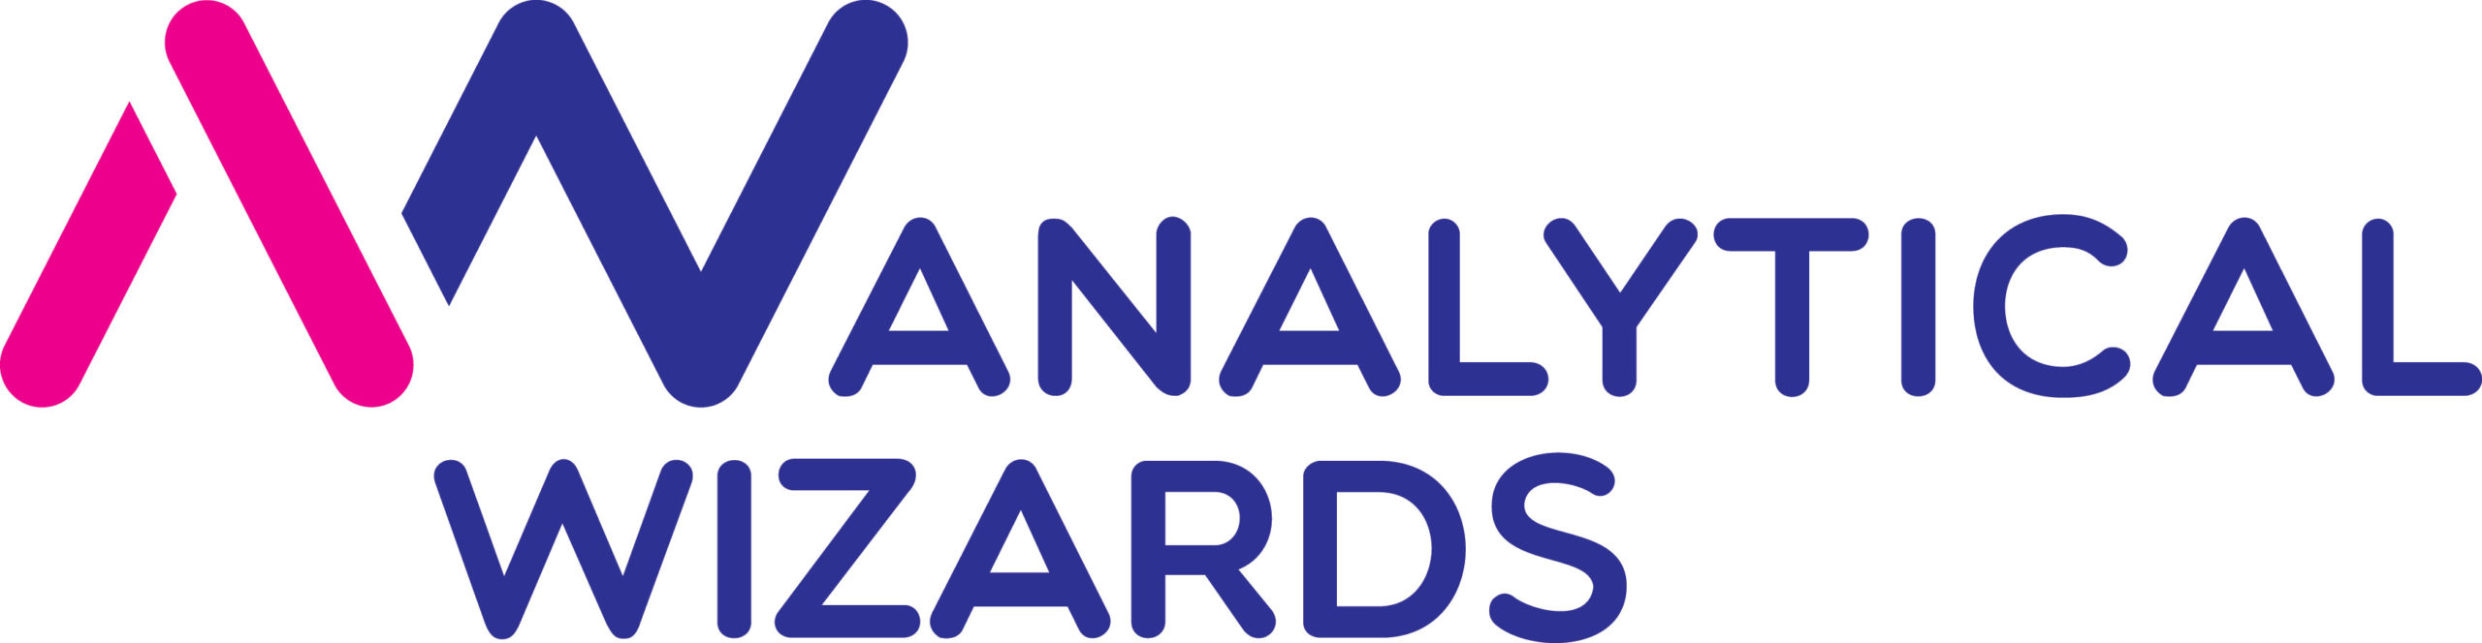









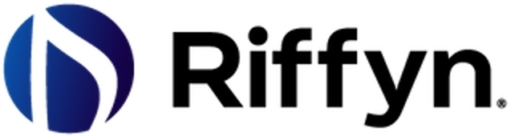

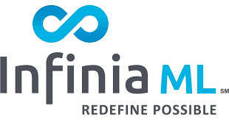

































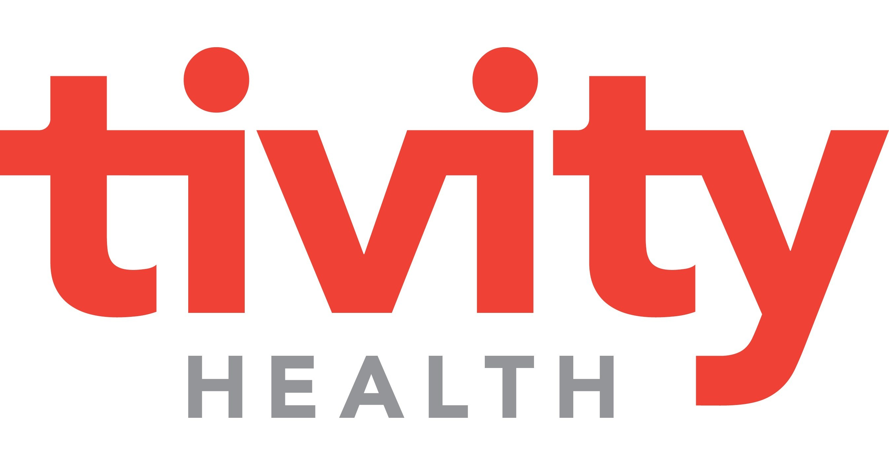


Reinserting Capitalism into Healthcare with Elan Adler, CEO of OneImaging | Podcast Episode Release | 11
Alantra – Select HealthTech Transactions
Advisor to CardioDiagnostics on its sale to CardioOne
Advisor to Kirkbi on its
investment in Amboss
Advisor to Labguru on its sale to Titian Software
Advisor to Blackford Analysis on its sale to Bayer
Advisor to Analytical Wizards on its sale to Definitive Healthcare
Advisor to Riffyn on its sale to Siemens
Advisor to WOOM on its sale to Apricity
Advisor to Infinia ML on its
sale to Aspirion
Advisor to CareCloud on the acquisition of Medmatica
Advisor to MTBC on the acquisition of Meridian
Advisor to MTBC on the
acquisition of CareCloud
Advisor to UpStream in its minority recap by Dragoneer Investment Group
Advisor to Confirma on its sale to Merative
Advisor to HNI Healthcare on its recap by Bison Capital
Advisor to Vikus on its sale to Symplr
Advisor to Skylight Healthcare Systems on its sale to
GetWell Network
Advisor to Health Care Dataworks on its sale to
Health Catalyst
Advisor to Intelligent Healthcare on its sale to Waystar
Adviser to MedVentive on its sale to McKesson
Advisor to Futuredontics on its sale to Dentsply Sirona
Advisor to Medical Collective Intelligence (division of Itochu) on its sale to OmniCom
Advisor to mScripts on its recap by Cardinal Health
Advisor to HealthHonors on its sale to Tivity Health
Advisor to Avantas on its sale to AMN Healthcare
Advisor to QualityHealth on its sale to Sharecare

Slide 12








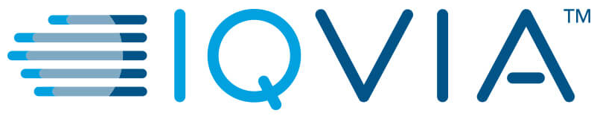













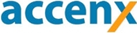
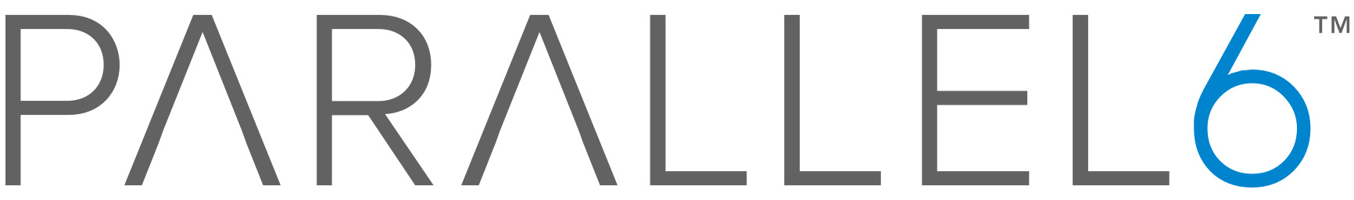










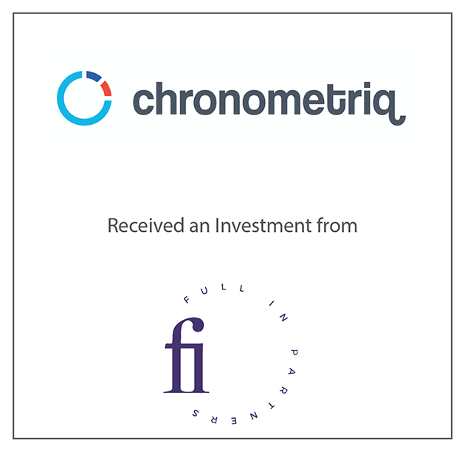


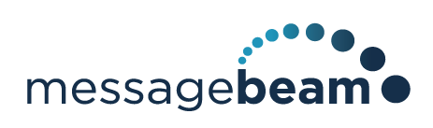





Reinserting Capitalism into Healthcare with Elan Adler, CEO of OneImaging | Podcast Episode Release | 12
Alantra – Select HealthTech Transactions
Advisor to Method Factory on its sale to Alere
Advisor to Quality Care Solution on its sale to Cognizant
Advisor to Franco Signor on its recap by BV Investment Partners
Advisor to Med-Vantage on its sale to IQVIA
Advisor to Prematics on its sale to NantHealth
Life Sciences Pricing and Contracting Solutions
Advisor to TruTag on its recap by CIC Capital Ventures
Advisor to Anju on its sale
to Valsoft
Advisor to MedData Group on its sale to IQVIA
Advisor to Medable on its recap by Sapphire Ventures
Advisor to Deloitte on the
sale of its Life Sciences Pricing and Contracting Solutions to Model N
Advisor to Chemical Computing Group on a majority investment from Altaris Capital Partners
Advisor to Accenx on its
sale to IBM
Advisor to Parallel 6 on
its sale to Icon
Advisor to NextDocs on its
sale to Aurea Software
Advisor to Aktana on its
recap by Novo Ventures and Transformation Capital
Advisor to GQ Life Sciences
on its sale to Aptean
Advisor to mPulse Mobile on the acquisition of Message Beam
Advisor to Chronometriq on its investment from Full In Partners
Advisor to DocMorris on the placement of convertible bonds
Advisor to Sonosite on its
sale to FujiFilm
Advisor to QualityHealth on
its minority preferred
investment from WebMD
Advisor to SigmaCare on its sale to Homecare CRM
Advisor to Analytical Wizards on a minority investment from a strategic investor
Co-manager of ~$200M of convertible seniors notes for Model N
Advisor to Medsphere on raising Senior Debt

Slide 13
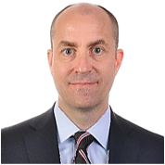

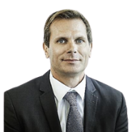
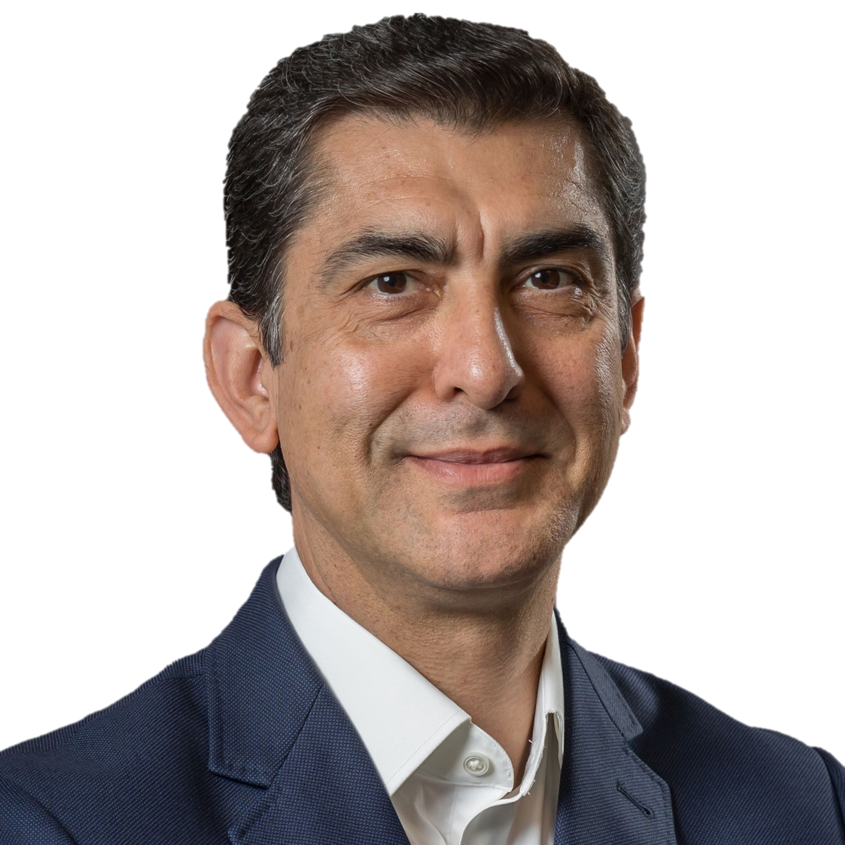
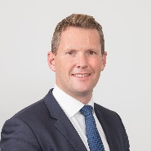

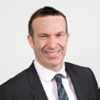
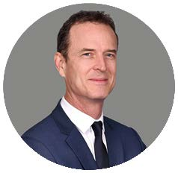

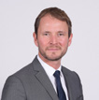
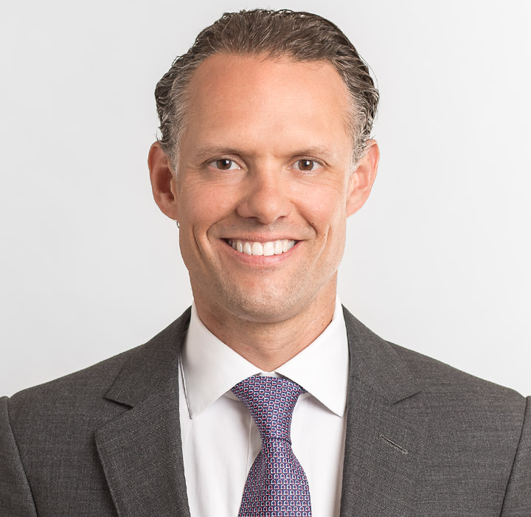





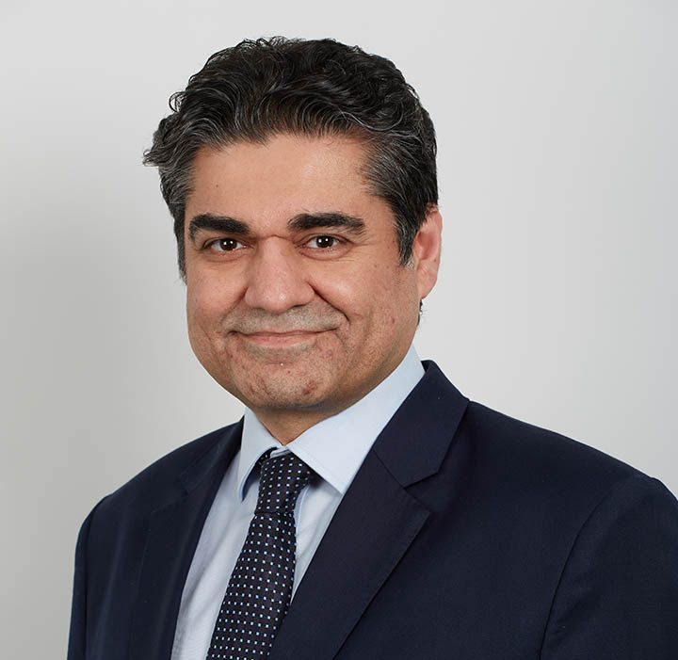

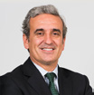

Reinserting Capitalism into Healthcare with Elan Adler, CEO of OneImaging | Podcast Episode Release | 13
Alantra – Global Senior Healthcare Team
Alantra benefits from a global senior Healthcare team with deep local presence, able to reach global strategics and investors
Rusty Ray
Managing Partner
rusty.ray@alantra.com
Frederic Laurier
Managing Director
frederic.laurier@alantra.com
Zeke Navar
Managing Director
zeke.navar@alantra.com
Matthew Wiseman
Partner
matthew.wiseman@alantra.com
Justin Crowther
Partner
justin.crowther@alantra.com
Fabrice Scheer
Managing Director
fabrice.scheer@alantra.com
Franck Noat
Managing Director
franck.noat@alantra.com
Michael Maag
Managing Partner
michael.maag@alantra.com
Jonas Bauréus
Managing Director
jonas.baureus@alantra.com
Gianni Casanova
Partner
gianni.casanova@alantra.com
Saad Ashraf
Managing Director
saad.ashraf@alantra.com
Guillermo Arbolí
Managing Director
guillermo.arboli@alantra.com

Slide 14

POSSIBILITY IS IN THE ASCENT
Alantra is a global investment banking, credit portfolio advisory, and alternative asset management firm focusing on the mid-market with offices across the US, Europe, Latin America, and Asia.
20
Offices Worldwide
500+
Financial Professionals
120+
Partners
Argentina
Benelux
Brazil
Chile
China
Colombia
France
Germany
Greece
Ireland
Italy
Nordics
Portugal
Spain
Switzerland
UAE
United Kingdom
United States
$605B+
Deal Volume
2,300+
Completed Transactions
1,590+
Clients Advised

